Slide 1
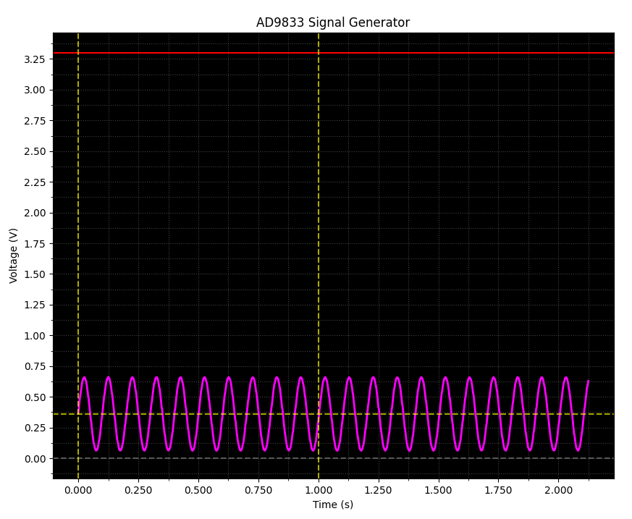
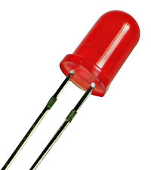
What if we want to blink an LED?
A light emitting diode (LED) requires +2.0V to shine visible light, so we must figure a way to boost the output voltage of the AD9833 chip

Slide 2
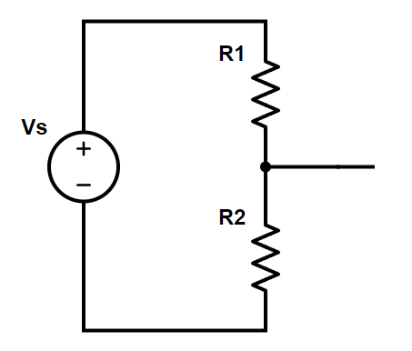









A Voltage Divider
KVL
$$V_{s}=v_{1}+v_{2}$$
Ohms
$$v_{1}=i_{1}R_{1}$$
330Ω
+3.3V
Ohms
$$v_{2}=i_{2}R_{2}$$
+ ?? V
KCL
$$i_{1}=i_{2}$$
+ 2.83V
$$V_{s}=i_{2}\left(R_{1}+R_{2}\right)$$
$$i_{2}=\frac{v_{2}}{R_{2}}$$
2KΩ
$$V_{s}=\frac{v_{2}}{R_{2}}\left(R_{1}+R_{2}\right)$$
$$v_{2}=V_{s}\frac{R_{2}}{\left(R_{1}+R_{2}\right)}$$
$$v_{2}=\left(3.3\right)\frac{2000}{\left(330+2000\right)}=2.83V$$

Slide 3
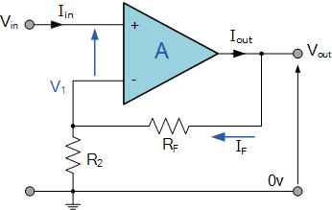
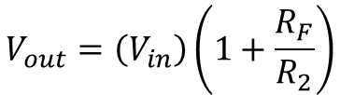





Operational Amplifiers
$$V_{1}=V_{in}$$
$$V_{1}=\left(V_{out}\right)\frac{R_{2}}{R_{2}+R_{F}}$$
$$V_{out}=R_{2}+R_{F}$$
R_{F} is the "feedback" resistor
$$V_{in}=\left(V_{out}\right)\frac{R_{2}}{R_{2}+R_{F}}$$
$$V_{out}=\left(V_{in}\right)\frac{R_{2}+R_{F}}{R_{2}}$$
$$V_{out}=\left(V_{in}\right)\left(1+\frac{R_{F}}{R_{2}}\right)$$

Slide 4
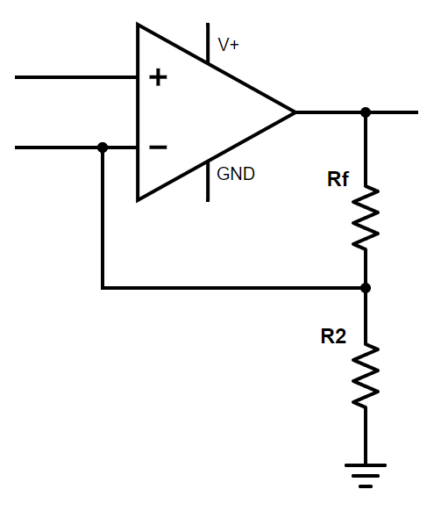
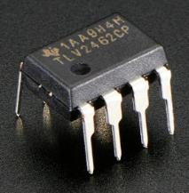

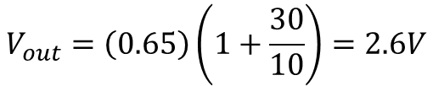
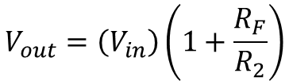
Operational Amplifiers
+3.3V
This circuit generates a 4x gain on the input
+0.65V
from the
AD9833
$$V_{in}$$
+2.6V ✓
30K Ω
$$V_{out}=\left(V_{in}\right)\left(1+\frac{R_{F}}{R_{2}}\right)$$
10K Ω
TLV2462 Op Amp
$$V_{out}=\left(0.65\right)\left(1+\frac{30}{10}\right)=2.6V$$

Slide 5
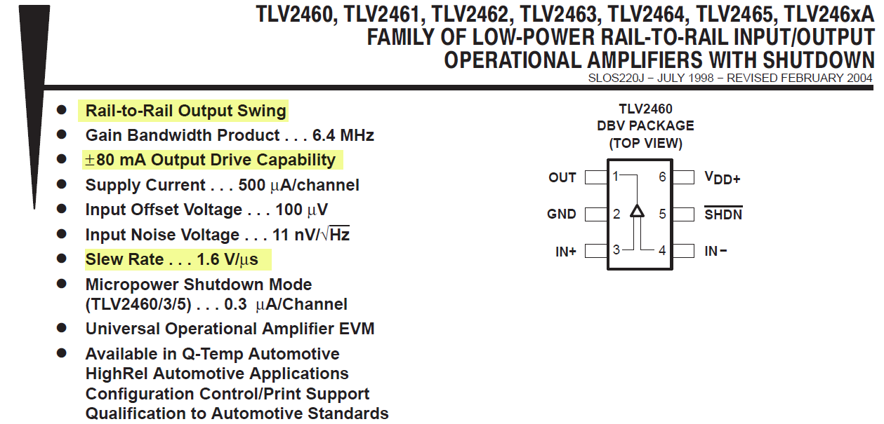
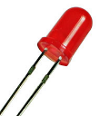
Always Consult the Product Datasheet
https://www.ti.com/lit/gpn/tlv2462
✓
Pin Out
✓
rail
rail
✓
+2.0V
20mA

Slide 6
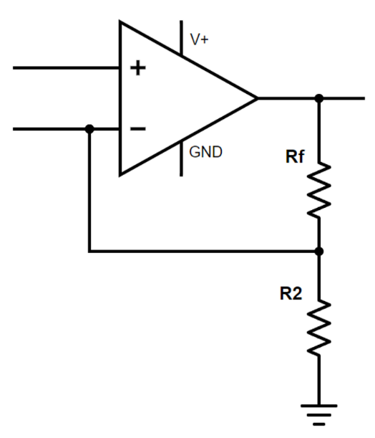
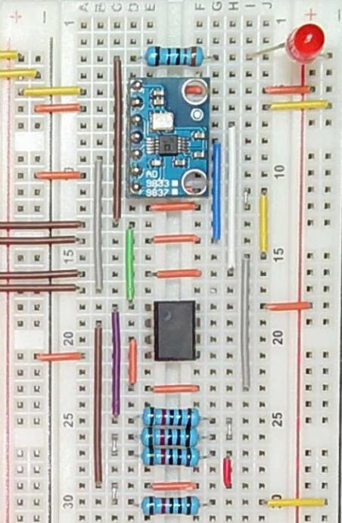
Mapping Logical ←→ Physical Layouts
The ability to map back-and-forth between a schematic and a circuit board is a skill that is in high demand!

Slide 7

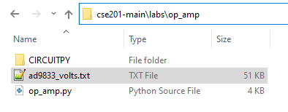
Copy Your sig_gen Output TXT File
Your Laptop
cse201-main/labs/sig_gen/
Your Laptop
cse201-main/labs/op_amp/
Via
Drag-n-Drop
Or
Cut-n-Paste
Confirm you wish to overwrite/replace ad9833_volts.txt

Slide 8
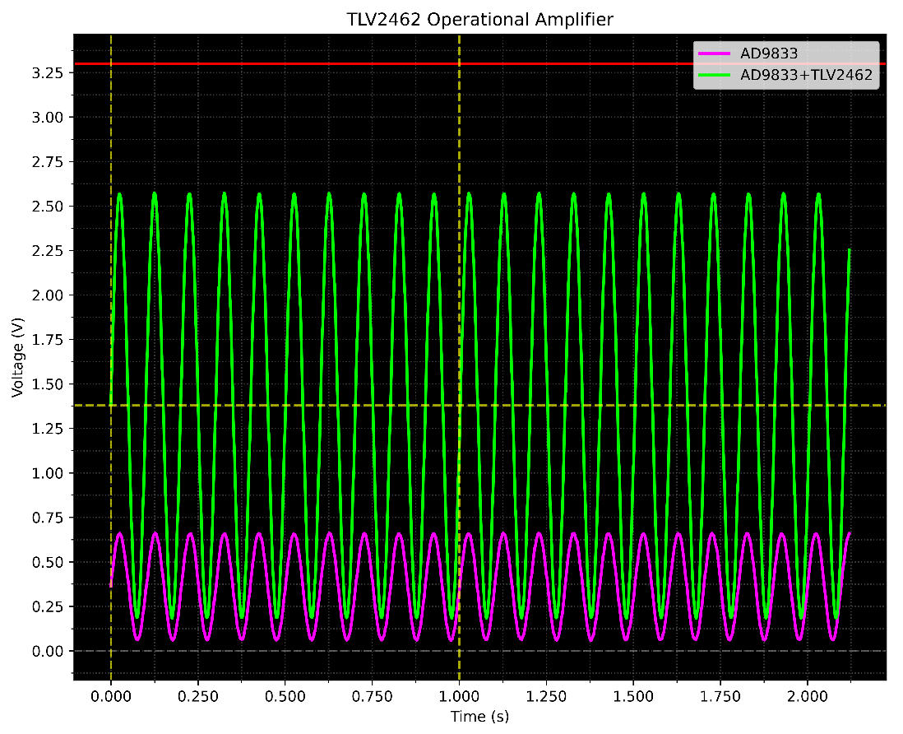
Check op_amp.py

Slide 9
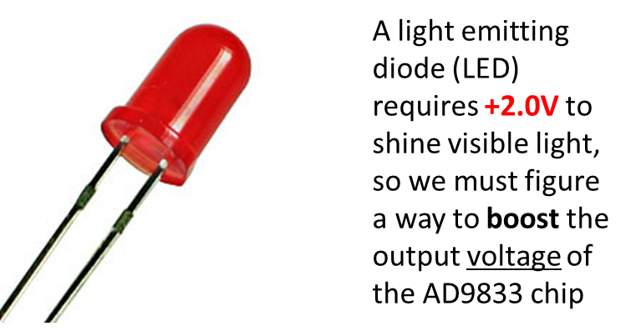
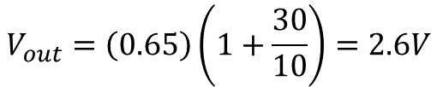
Check op_amp.py
$$V_{out}=\left(0.65\right)\left(1+\frac{30}{10}\right)=2.6V$$

Slide 10
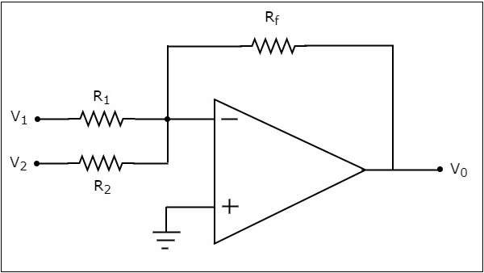
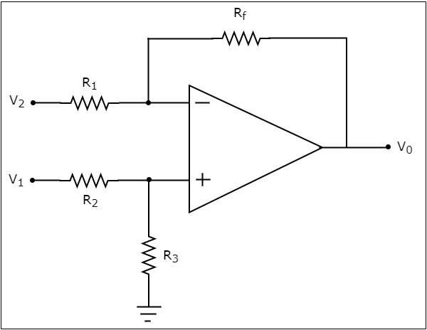
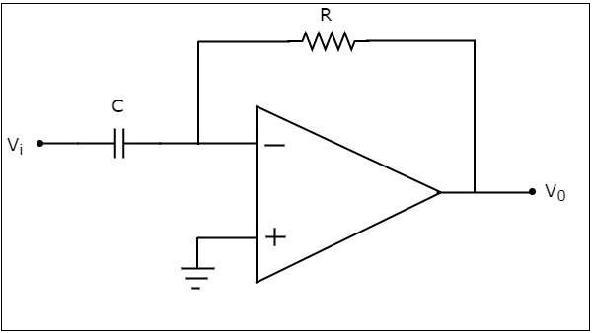
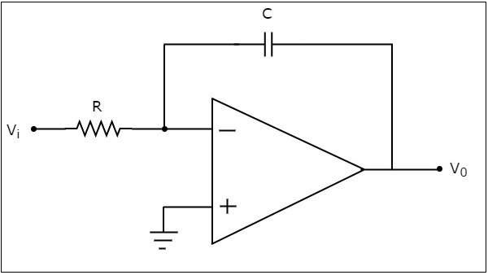
Operational Amplifiers
"Adder"
"Subtractor"
"Differentiator"
"Integrator"

Slide 11
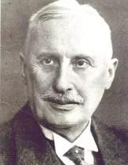
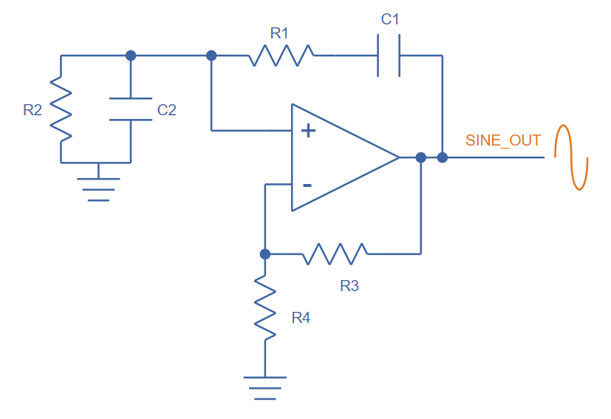

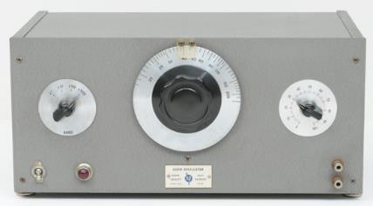
Operational Amplifiers
Wien Bridge Oscillator (1891)
Max Wien
1866-1938
Bill Hewlett & David Packard
HP 200A (1939)
https://en.wikipedia.org/wiki/Fantasound
(1940)

